Slide 1
Technical Session 1: Intangibles – where to go next
Technical Session 1
Dr Keith Kendall

Slide 2
Agenda
AASB Staff Paper
Post-publication Outreach
AASB Agenda Consultation
Digital Assets
Next Steps

Slide 3
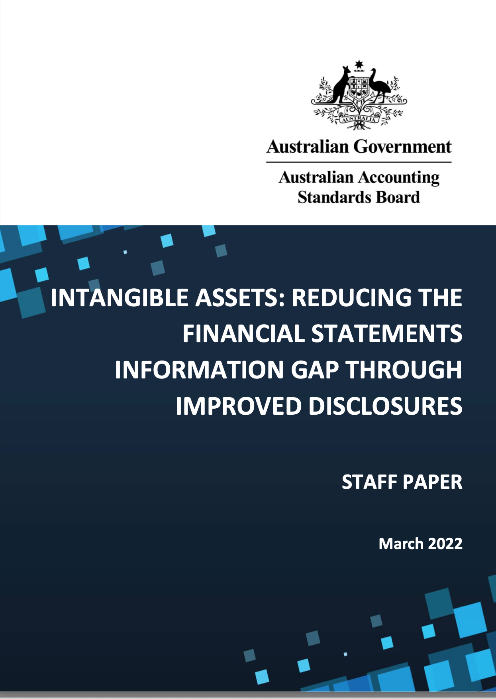
AASB Staff Paper: Intangible Assets: Reducing the Financial Statements Information Gap Through Improved Disclosures
Stimulate open debate about viable methods for closing perceived financial statement information gaps linked to intangible assets
OBJECTIVE
Unrecognised internally-generated intangible assets
FOCUS

Slide 4
Overview
DISCLOSURE OBJECTIVE
PRINCIPLE
GUIDANCE
An entity discloses information in its financial statements about each significant unrecognised internally-generated intangible asset controlled by the entity that plays a key role in pursuing the entity’s objectives.
To provide information in the FS that enable users to assess the current and expected future financial impact on the entity and management’s stewardship of each significant unrecognised internally-generated intangible asset controlled by the entity.
To assist entities in determining disclosures that can meet the principle and the disclosure objective.

Slide 5
Examples
description of the asset
expected useful life
reasons it failed the recognition criteria
any legal restrictions on its title
whether it plays a key role in the pursuit of the entity's objectives
new internally generated, or held for sale, abandoned or sold
operating segment in which it is used

Slide 6
Post-publication Outreach
Agree with focusing on disclosures, with some concerns
1
2
3
4
5
01
Proprietary information
Audit effort
Location of the disclosure
entities may reveal confidential and sensitive information
disclosures may increase audit effort and risks
whether disclosures should be made in FS
generic information is not useful
should disclosure be made mandatory or voluntary
Mandatory or voluntary
Boilerplate disclosures

Slide 7
AASB Agenda Consultation
Stakeholder feedback
Improvement is needed considering the importance of intangibles in today's economy (e.g. emerging assets such as digital assets)
Disconnection between acquired intangible assets and certain internally-generated intangible assets
Need for greater clarity about intangibles and their interactions with sustainability reporting and management
commentary
AASB added intangible assets to its research work program

Slide 8
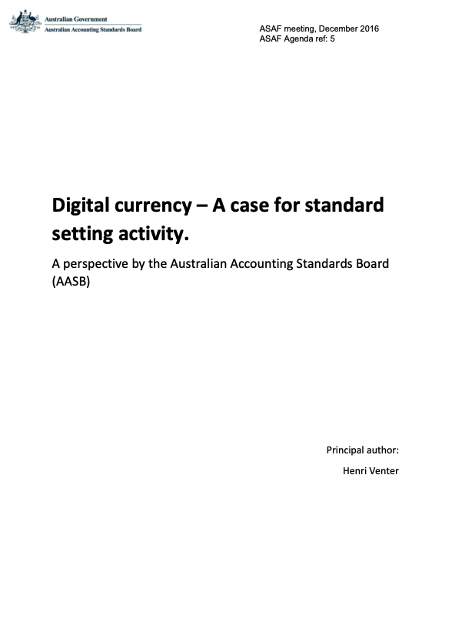
Digital Assets
published AASB's perspective in December 2016
Ongoing monitoring and research
Current work
Focus on crypto-assets
Collaborating with CPA Australia and UNSW researcher
Outreach to gather views:
Pervasiveness
Accounting and reporting concerns
AASB Virtual Dialogue Series
8 February 2023
4-5.15 pm (AEDT)

Slide 9
Next Steps
Developing
project plan
Potential research projects
judgement used in practice in determining capitalising research and development costs
Stakeholders’ understanding of 'proprietary information'
further studies on intangible asset disclosures
Collaborate with standard-setters and researchers

